Slide 1
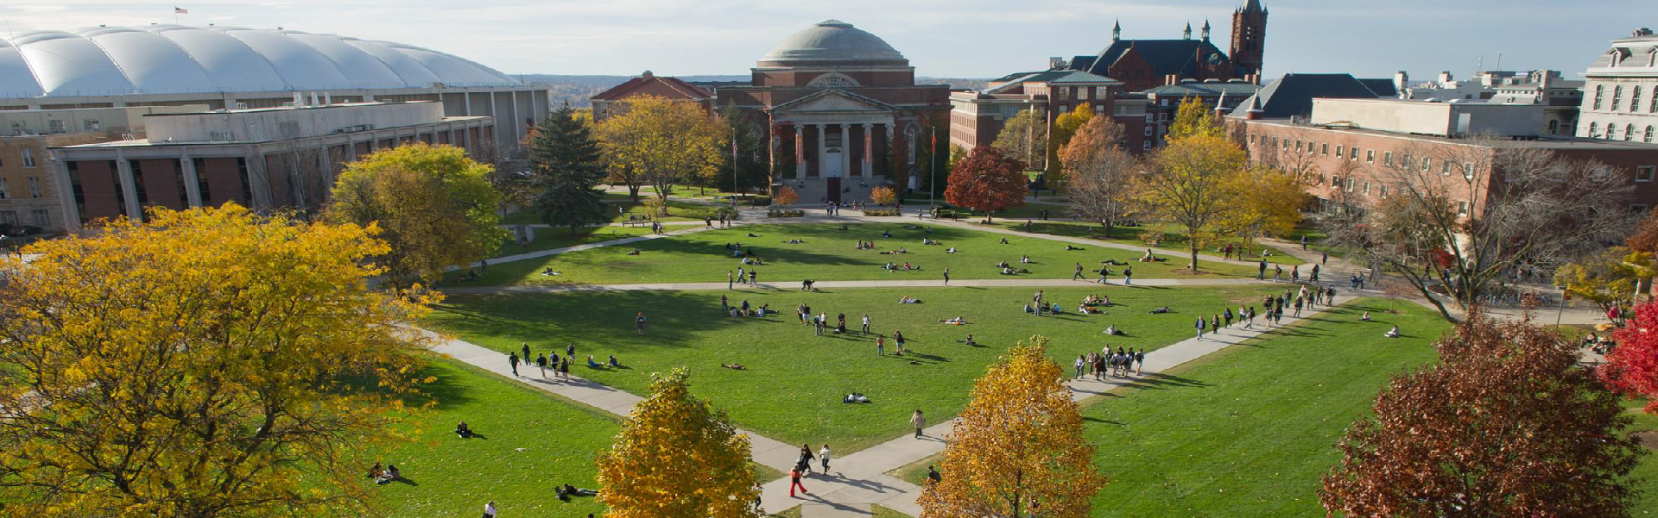

Applied Data Science Program – Spring 2024
IST 782 Applied Data Science Portfolio
Nolan Arendt

Slide 2
Program Learning Goals
Collect, store, and access data by identifying and leveraging applicable technologies.
Create actionable insight across a range of contexts (e.g., societal, business, political), using data and the full data science life cycle.
Apply visualization and predictive models to help generate actionable insight.
Use programming languages such as R and Python to support the generation of actionable insight.
Communicate insights gained via visualization and analytics to a broad range of audiences (including project sponsors and technical team leads).
Apply ethics in the development, use and evaluation of data and predictive models (e.g., fairness, bias, transparency, privacy).

Slide 3
Course Projects Selected
Course | Project | Learning Goals
IST 652 – Scripting for Data Analysis | Analyzing Viewer Voting Trends in Classic and Modern Cinema | 1, 5
IST 664 – Natural Language Processing | Detection of Spam in Emails | 4, 6
IST 687 – Introduction to Data Science | Ames IA Housing Market Analysis: 2006-2010 | 2, 3
IST 691 – Deep Learning in Practice | Pistachio Type Classification | 1, 6
IST 707 – Applied Machine Learning | Predicting COVID-19 Diagnosis | 3, 6

Slide 4
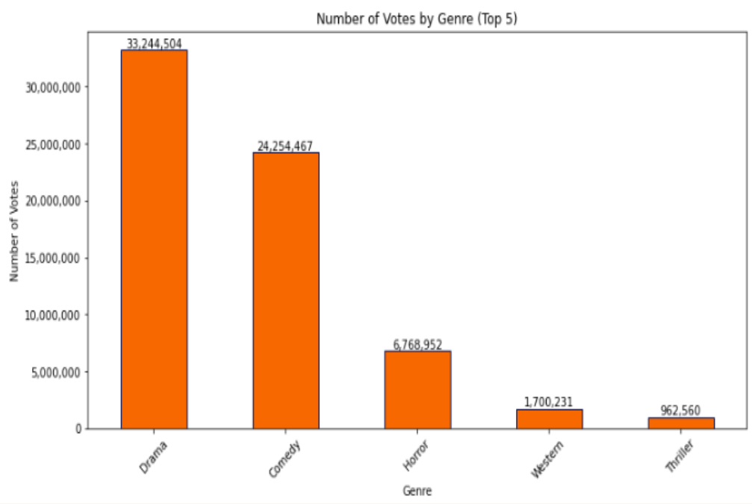
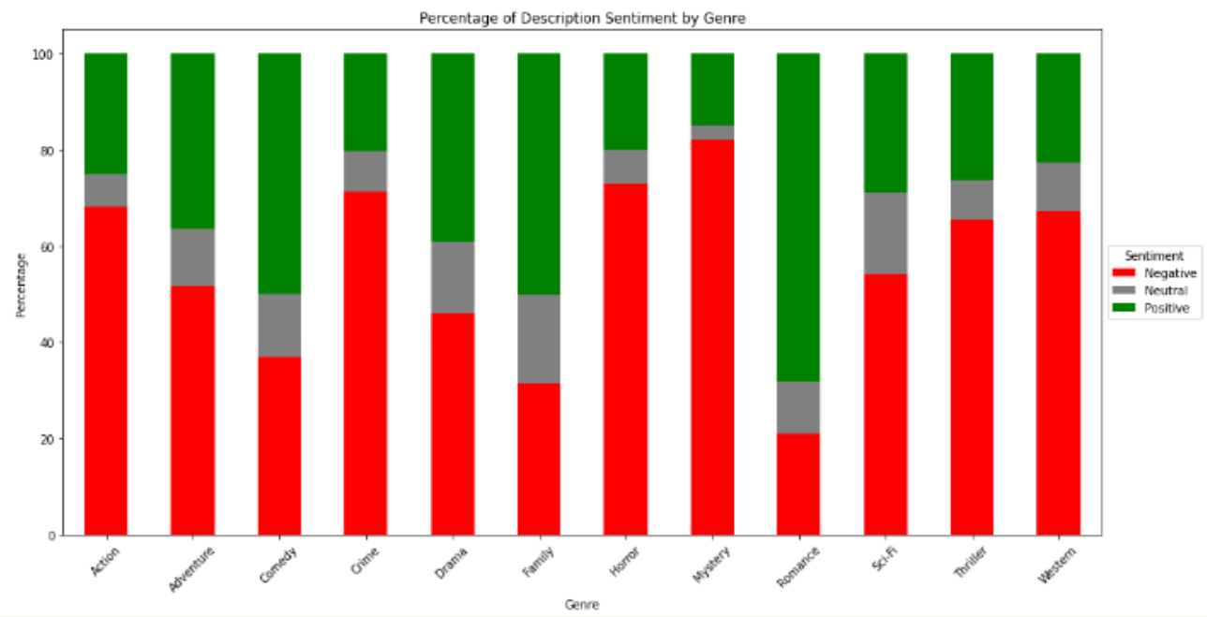
IST 652 – Scripting for Data Analysis
Project: Analyzing Viewer Voting Trends in Classic and Modern Cinema
Description: Developed a program to analyze movie review data focusing on viewer voting trends across genres, countries of origin, and demographics. Conducted extensive exploratory data analysis (EDA) to provide insights for production executives.
Key Findings:
Drama and Comedy are the most popular genres.
Positive sentiment in plot descriptions correlates with higher votes.
Gender-based analysis showed women rated movies higher than men.
Learning Goals:
Goal 1: Gathered and managed movie data from Kaggle using Python’s pandas library.
Goal 5: Created visualizations with matplotlib and seaborn to communicate insights to non-technical audiences.

Slide 5
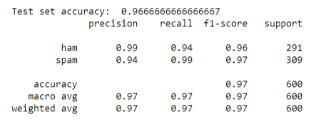
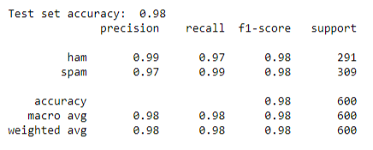
IST 664 – Natural Language Processing
Project: Detection of Spam in Emails
Description: Explored machine learning techniques to classify emails as spam or authentic using the Enron corpus. Compared several models, including Naïve Bayes, Logistic Regression, Random Forest, and Gradient Boosting.
Key Findings:
Logistic Regression and Gradient Boosting achieved the highest accuracy rates.
Gradient Boosting demonstrated perfect precision in classifying ham emails.
Learning Goals:
Goal 4: Used Python to preprocess data and implement machine learning models for spam detection.
Goal 6: Ensured model fairness and transparency by using a balanced dataset and evaluation techniques like cross-validation.

Slide 6
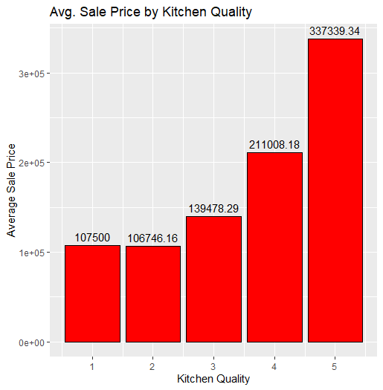
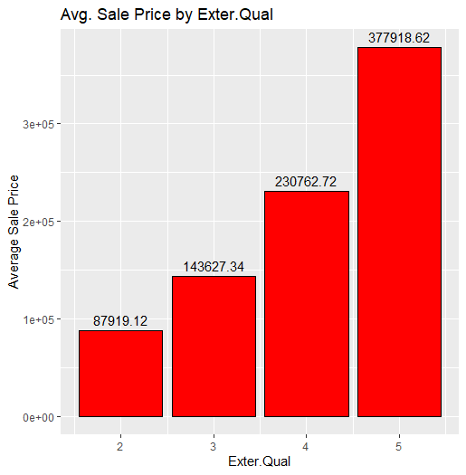
IST 687 – Introduction to Data Science
Project: Ames IA Housing Market Analysis: 2006-2010
Description: Analyzed the Ames, Iowa housing dataset to identify key features impacting the return on investment (ROI) for housing attributes. Conducted correlation and linear regression analyses to determine the most significant variables influencing sale prices.
Key Findings:
Kitchen quality, basement height, and exterior quality were the most impactful factors on sale prices.
Upgrading these features can significantly increase ROI for homebuyers and investors.
Learning Goals:
Goal 2: Identified key ROI features in housing prices using data cleaning, feature engineering, and regression analysis in R.
Goal 3: Applied R’s ggplot2 and dplyr for visualizations and linear regression models for predictive insights.

Slide 7
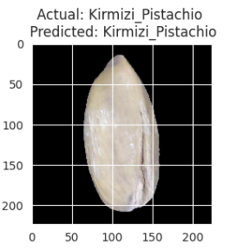
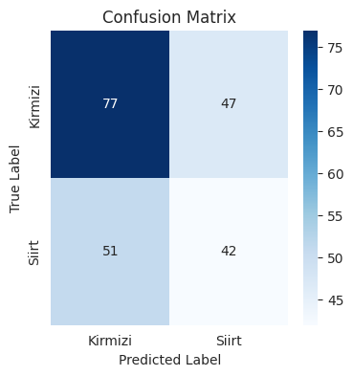
IST 691 – Deep Learning in Practice
Project: Pistachio Type Classification
Description: Used Convolutional Neural Networks (CNNs) to classify images of pistachios into two species: Kirmizi and Siirt. Implemented data augmentation techniques and developed models using EfficientNetB0 and VGG16 architectures.
Key Findings:
EfficientNetB0 achieved a test accuracy of 98.46%, although with a large bias.
VGG16 provided a significantly better balance between the two species.
Learning Goals:
Goal 1: Collected and managed pistachio image data, using TensorFlow and Keras for preprocessing, data augmentation, and data balancing.
Goal 6: Addresses model bias through data augmentation, data balancing, and fine-tuning to ensure fair and accurate classifications for both species.

Slide 8
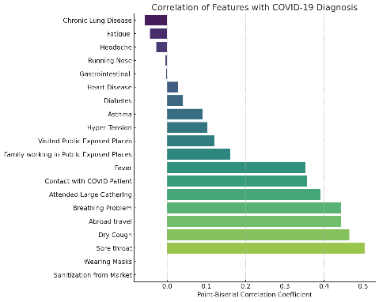
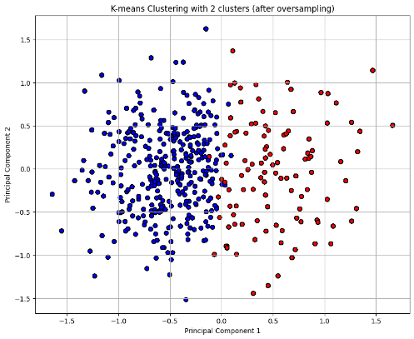
IST 707 – Applied Machine Learning
Project: Predicting COVID-19 Diagnosis
Description: Developed predictive models to determine the likelihood of a COVID-19 diagnosis based on reported symptoms and behavioral attributes. Explored classification algorithms like Logistic Regression, Random Forest, and Decision Tree.
Key Findings:
Logistic Regression achieved the highest accuracy at approximately 83.63%.
Highlighted the importance of handling class imbalances either through preprocessing or specific model parameter choices.
Learning Goals:
Goal 3: Developed and evaluated classification models for COVID-19 predictions, using confusion matrices for performance visualization.
Goal 6: Maintained ethical standards by addressing class imbalances and ensuring transparent methodology in model development.

Slide 9
Thank You!
Nolan Nicholas Arendt | Applied Data Science Program
Syracuse University
Email: nnarendt@syr.edu
GitHub: https://github.com/nolanarendt/IST782-Applied-Data-Science-Portfolio
LinkedIn: https://www.linkedin.com/in/nolanarendt/

